Slide 1


Spam detection using
machine learning
Presented by: (Team no 5)
Madhuri Shriniwar
Tejal Gadekar
Guided by:
Prof. Mrudul Dixit

Slide 2
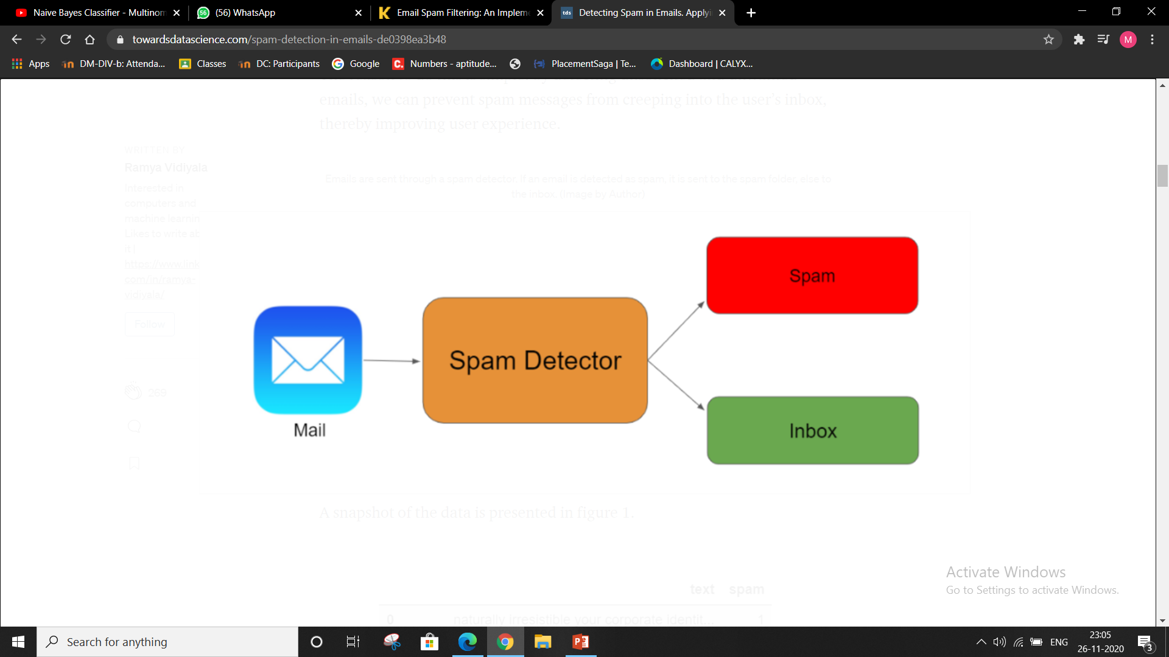
Introduction
Email is an effective, faster and cheaper way of communication.
It is expected that the total number of worldwide email accounts is increased from 3.3 billion email accounts in 2012 to over 4.3 billion by the end of year 2016'
Spam is an unwanted, junk, unsolicited bulk mails, used to spreading virus, Trojans, malicious
code, advertisement or to gain profit on negligible cost.
Ham is a legitimate, wanted, solicited mails.
Ham

Slide 3
Objective
To give knowledge to user about fake mails and relevant mails
To classify mail is spam or non spam
It increases security and control

Slide 4
Literature survey
Sr.No | Paper Reference | Summary
1. | Email Spam Detection using integrated approach of Naïve Bayes and Particle Swarm Optimization (https://ieeexplore.ieee.org/document/8662957) | In this paper, integrated approach of NB and PSO for the email spam detection is used. NB having probability distribution property determines the possible class for the email content from the spam class or non-spam class on the basis of keywords present in the email textual data. PSO is used to further optimize the parameters like precision, recall, f-call, etc. of NB approach to improve the accuracy, search space and classification process. Correlation based feature selection (CFS) is used as a feature selection approach.
2. | Spam Filtering with Naive Bayes – Which Naive Bayes? (https://www.researchgate.net/publication/221650814_Spam_Filtering_with_Naive_Bayes_-_Which_Naive_Bayes ) | Multivariate Bernoulli NB, muti-nomial NB(TF attribute), multi-nomial NB(Boolean attribute), Multivariate Gauss NB and Flexible Bayes are the 5 versions of NB algorithm. Out of these 5 versions, multinomial with Boolean attribute and Flexible Bayes give best performance. Multinomial(Boolean attributes) NB has low computational complexity at run time, so it is mostly preferred over Flexible Bayes.

Slide 5

Approaches:
KNN Algorithm
Support vector machine
Naïve Baye’s algorithm
Decision tree
Random forest

Slide 6
Flowchart
Dataset
Collection of raw data
Preprocessing of data
Splitting of dataset
Training dataset
Testing dataset
NB classifier
Spam
Ham

Slide 7
Natural Language Processing
Natural Language Processing:
NLP is a field in machine learning with the ability of a computer to understand, analyze, manipulate, and potentially generate human language.
NLTK: (Natural Language toolkit)
NLTK is a popular open-source package in Python. Rather than building all tools from scratch, NLTK provides all common NLP Tasks.
Corpus :
Large collection of words or sampled text provided by NLTK

Slide 8
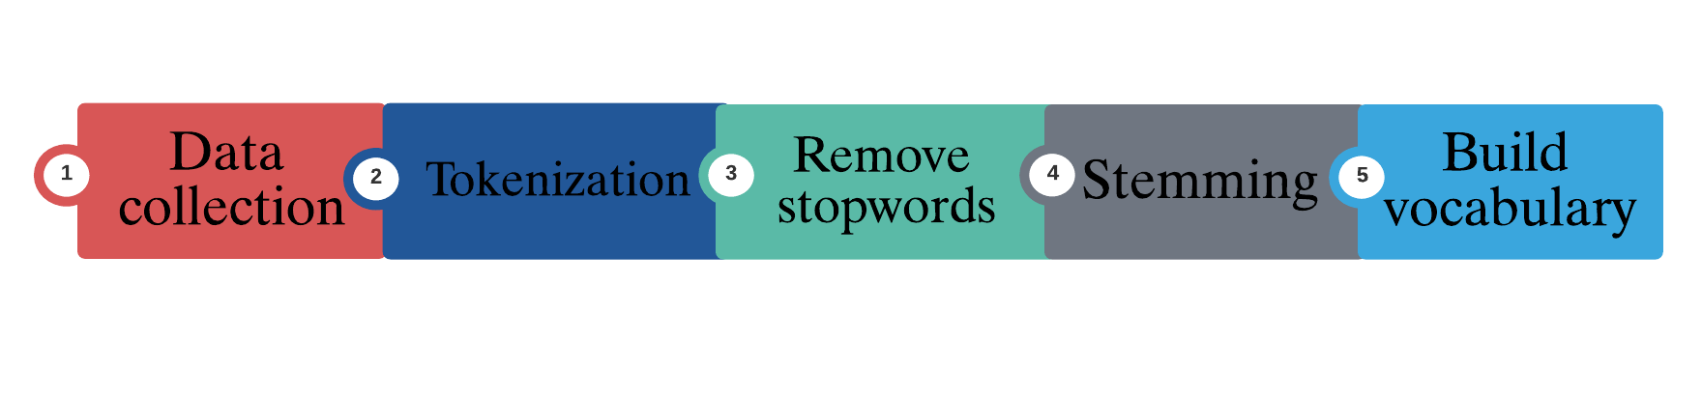
Pre-processing of data:
Cleaning up the text data is necessary to highlight attributes that we’re going to want our machine learning system to pick up on.

Slide 9
Preprocessing Stages
Tokenization:
Tokenization is splitting a phrase, sentence, paragraph, or an entire text document into smaller units. Each of these smaller units are called tokens.
Word tokenize: to split a sentence into tokens or words
Sentence tokenize: to split a document or paragraph into sentences
Stopword Removal:
Stopwords are the most common words in any natural language.
For the analyzing text data and building NLP models, these stopwords don't add much value to the meaning of the document.
NLTK has a list of stopwords stored in 16 different languages.

Slide 10
Preprocessing Stages
Stemming:
Stemming is a technique used to extract the base form of the words by removing affixes from them.
1.Porter stemmer
2.lancaster stemmer
3.Regexp Stemmer
4.Snowball Stemmer
Build Vocabulary:
Creating Bag of words and each word is termed as feature.

Slide 11
Naïve Baye’s Algorithm
Probability based machine learning algorithm
Text classification
Bag of word(feature)
Naïve’s because of independent assumptions.
Formula for calculating conditional probability
P(H ) : Probability of hypothesis H being true => prior probability
P(E ) : Probability of evidence regardless of hypothesis
P( H /E ) : Probability of hypothesis given that evidence is there=> Posterior
probability
P ( E /H) : Probability of evidence given that hypothesis is true=> Likelihood
P( H/E) = P( E/H) * P(H)
-----------------
P(E)

Slide 12
Example
P(Spam/word)=[P(word/Spam)*P(Spam)]/P(word)
E.g. Calculate the probability of word “discount”
P(Spam/”discount”)= [P(“discount”/Spam)*P(Spam)] / P(“discount”)
P(Ham/”discount”)= [P(“discount”/Ham)*P(Ham)] / P(“discount”)
Final prediction: Compare the posterior probabilities and select greatest one.
Laplace smoothing: Solve the problem of zero probability
Add 1 to the numerator

Slide 13
Specifications
Software used:
a)Python 3.9.2
b)Anaconda, Jupyter Notebook, Google Colab
Dataset: kaggle
Algorithm Naive baye’s Algorithm
Library used pandas,numpy,NLTK,Sklearn
Os platform windows 10

Slide 14
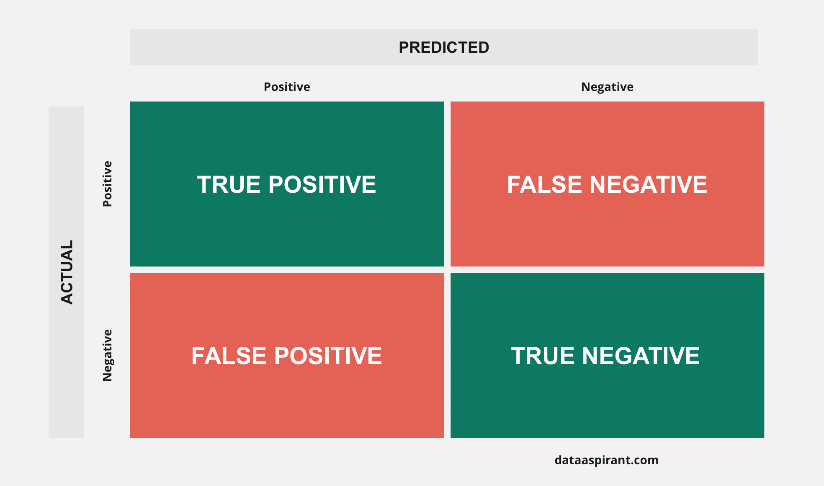
Results
Confusion matrix
Confusion Matrix
Precision
Recall
F-Score
Accuracy

Slide 15
Results
Precision:
It represents the model’s ability to correctly predict the positives out of all positive prediction it made
Precision score: TP
TP+FP
Recall: It defines the probability of actual detection of email spam.
Recall: TP
FN+TP
Confusion Matrix
Precision
Recall
F-Score
Accuracy

Slide 16
Results
F1-score: It represents the model score as a function of precision and recall score.
F1-score: 2*precisIon score* recall
(Precision+recall)
Accuracy score: Accuracy can be defined as the ratio of correctly predicted values to total data values
Accuracy score: TP + TN
TP+FP+FN+TN
Confusion Matrix
Precision
Recall
F-Score
Accuracy

Slide 17
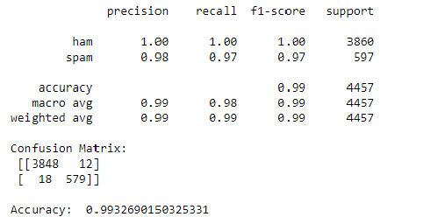
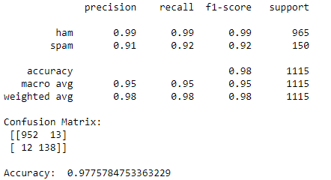
Testing results
Training results

Slide 18
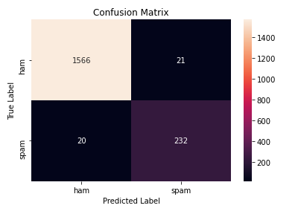
Confusion Matrix

Slide 19

Applications
Direct Marketing
Fraud Detection
Text Classification
Spam Filtering

Slide 20
Conclusion
We are able to classify the emails as spam or non-spam.
We have used natural language processing for preprocessing of data
We discussed and evaluated spam ﬁltering context with the Naive Bayes (nb) classiﬁer.
we have calculated accuracy of training set (99.33%)and testing set (97.77%) as well
Its model training and prediction times are very fast for the amount of data it can handle.

Slide 21
References
https://ieeexplore.ieee.org/document/8662957
https://www.researchgate.net/publication/221650814_Spam_Filtering_with_Naive_Bayes_-_Which_Naive_Bayes
https://towardsdatascience.com/spam-detection-in-emails-de0398ea3b48
https://www.researchgate.net/publication/345127329_Email_Spam_Detection_using_Naive_Bayes_and_Particle_Swarm_Optimization
https://www.datasciencelearner.com/naive-bayes-classifier-spam-filter-example/
https://www.youtube.com/watch?v=2qjhXfkg7pM&t=7563s
https://www.kaggle.com/oriol1/email-spam-classification
https://towardsdatascience.com/spam-messages-classification-3a7ede4f8ba1
https://www.kdnuggets.com/2020/07/spam-filter-python-naive-bayes-scratch.html
https://towardsdatascience.com/na%C3%AFve-bayes-spam-filter-from-scratch-12970ad3dae7

Slide 22
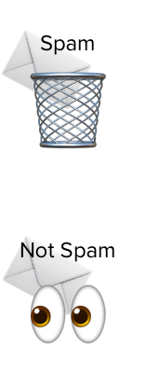
Abstract
In today’s world, the internet has brought a tremendous change in e-commerce aspect of people’s lives. However, it is prone to the wide variety of security attacks.
One of the most vulnerable security threat which poses a problem to the internet users is phishing mails.
Email Spam has become a major problem nowadays, with rapid growth of internet users, Email spams is also increasing.
People are using them for illegal and unethical conducts, phishing and fraud. Sending malicious link through spam emails which can harm our system and can also seek in into your system.
Creating a fake profile and email account is much easy for the spammers, they pretend like a genuine person in their spam emails, these spammers target those peoples who are not aware about these frauds. So, it is needed to Identify those spam mails which are fraud.

